Slide 1
Crescat Firmwide Presentation
The information contained herein is provided for informational purposes only and is not an offer of securities or the services of Crescat.
January 2025

Slide 2
Crescat’s Hedge Fund Strategies
Composition
Crescat Global Macro Fund
Crescat’s flagship fund and its most comprehensive strategy with exposure to all the firm’s macro themes.
Crescat Global Macro Fund
Crescat Long/Short Fund
Crescat Precious Metals Fund
Crescat Precious Metals Fund
Natural Resource Equity
An activist fund focused on precious and base metals mining.
Long/Short Equity
Commodity & Activist Metals
Crescat Long/Short Fund
Our equity-focused hedge fund seeks to deliver alpha from long and short stock picking combined with macro themes.
Strategies are actively managed and subject to change

Slide 3
Crescat’s Investment Process
Primary Values & Supporting Methods
Quant
Models
Development and expression of tactical macroeconomic themes.
Proprietary valuation-based research.
Quant models
AI Quantamental Equity
Macro
Precious Metals
Energy
Hiring of industry professionals whom we consider to be experts in their field.
Risk management that embraces volatility to realize intrinsic value.
Macro
+ Fundamental Value
Thematic Approach
Industry
Experts
Risk
Management
Strategies are actively managed and subject to change

Slide 4
Overarching Macro Theme: The Great Rotation
Overvalued Long Duration Financial Assets
Related Subthemes
Megacap Tech Overvaluation
Recession Watch
Widening Credit Spreads
Yield Curve Steepening
Fiscal & Monetary Policy Consequences
Related Subthemes
Entrenched Inflationary Pressures
Government Debt & Deficit Challenges
Stagnating Growth
Weakening US Dollar
Commodity Supply & Demand Imbalances
Related Subthemes
Precious Metals Mining
Energy Transition Metals
Agricultural Commodities
Oil & Gas
Commodity Rich Emerging Markets
Strategies are actively managed and subject to change

Slide 5
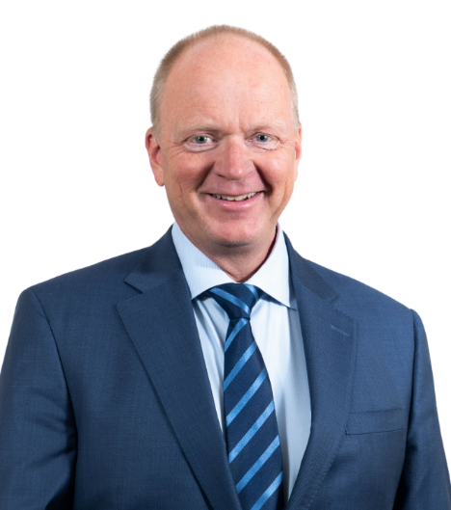
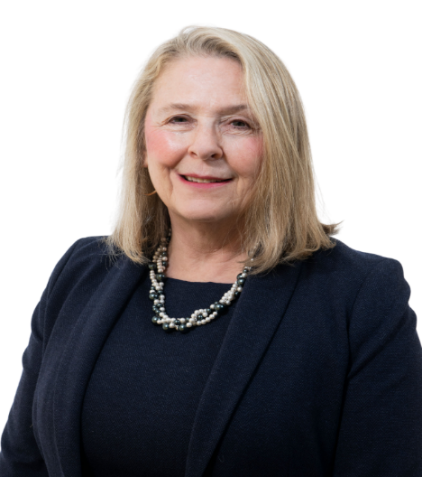
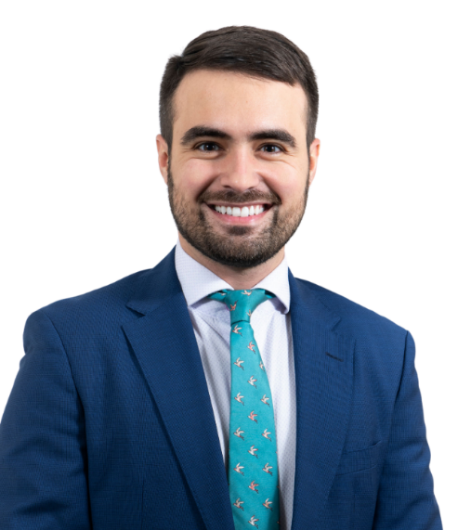
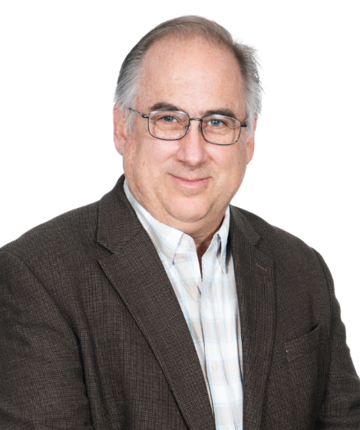
Leadership Team Bios
Kevin C. Smith, CFA
Member/CEO & Chief Investment Officer
Linda Carleu Smith, CPA
Member/Chief Operating Officer
Otavio “Tavi” Costa
Member/Macro Strategist
Quinton Hennigh, PhD
Member/Geologic & Technical Advisor
Kevin is the Founder, CEO, and CIO of Crescat Capital. He has managed investment portfolios since 1992, a career spanning multiple business cycles. Kevin has been the lead Portfolio Manager of the firm’s various investment strategies since their respective inceptions, with the earliest starting in 1999. He is the creator of Crescat’s firmwide global macro investment process and systematic equity valuation model. Prior to founding Crescat, he worked as a Wealth Advisor with Kidder Peabody. He earned an MBA from the University of Chicago Booth School of Business with a specialization in Finance and a concentration in Statistics. He was born and raised in the San Francisco Bay Area and received a bachelor’s degree in Economics and German studies from Stanford University. He holds the Chartered Financial Analyst designation.
Linda is a Co-Founder of Crescat Capital. As Chief Operating Officer, she manages Crescat’s business operations, including finance, regulatory compliance, and client service. In prior roles at Crescat and its predecessor companies, she has served as Controller from 1997-2012 and the in dual position of Chief Financial Officer & Chief Compliance Officer from 2012-2015. She became COO in 2015. Linda came to Crescat with significant investment industry and public accounting experience from prior employment at Kidder Peabody and EKS&H (now Plante Moran) and corporate experience as Controller of Pharmajet, a biotech company. She was born and raised in New Jersey. She earned an MBA from the University of Chicago, Booth School of Business and a BA in English Language and Literature from Tufts University. She is a Certified Public Accountant.
Tavi is a Member and Macro Strategist at Crescat Capital and has been with the firm since 2013. He built Crescat’s macro model that identifies the current stage of the US economic cycle through a combination of 16 factors. His research has been featured in financial publications such as Bloomberg, The Wall Street Journal, CCN, Financial Post, The Globe and Mail, Real Vision, and Reuters. Tavi is a native of São Paulo, Brazil and is fluent in Portuguese, Spanish, and English. Before joining Crescat, he worked with the underwriting of financial products and in international business at Braservice, a large logistics company in Brazil. Tavi graduated cum laude from Lindenwood University in St. Louis with a B.A. degree in Business Administration with an emphasis in Finance and a minor in Spanish. Tavi played NCAA Division 1 tennis for Liberty University.
Quinton is an economic geologist with 40+ years of operating and investment experience in the precious metals mining industry. He earned a PhD in Geology and Geochemistry from the Colorado School of Mines. He worked as an exploration geologist for major global mining firms including Homestake Mining (now Barrick Gold), Newcrest Mining, and Newmont Mining. He later led several exploration-focused mining firms as an executive. Dr. Hennigh joined Crescat in 2021 as a member of the investment team. Quinton now acts in an advisory role. Since 2023, he has also served as Chairman and CEO of San Cristobal Mining (SCM), a Crescat activist investment and leading worldwide producer of silver and zinc. SCM’s acquisition of Minera San Cristobal from Sumitomo in 2023 and the advancement of its Isidorito silver deposit in Bolivia are among Quinton’s outstanding career achievements. He has made valuable contributions to other successful projects that include Kirkland Lake Gold’s acquisition of the Fosterville mine in Australia and the discovery and advancement of various tier-1 mineral assets worldwide, including New Found Gold’s Queensway discovery in Newfoundland, Eloro Resources’ Iska Iska silver/polymetallic deposit in Bolivia, Snowline Gold’s Valley deposit in the Yukon, and Goliath Resources’ Surebet gold discovery in British Columbia among others.
Crescat Firmwide Presentation

Slide 6
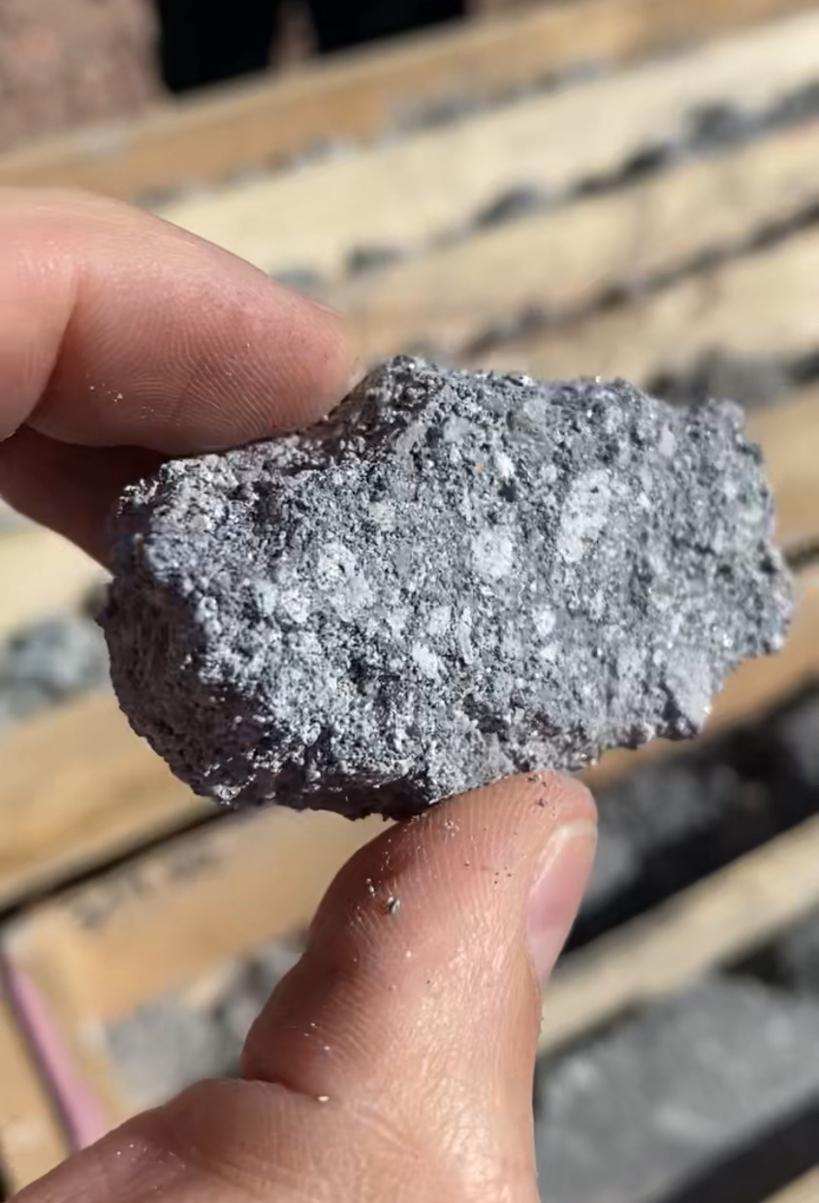
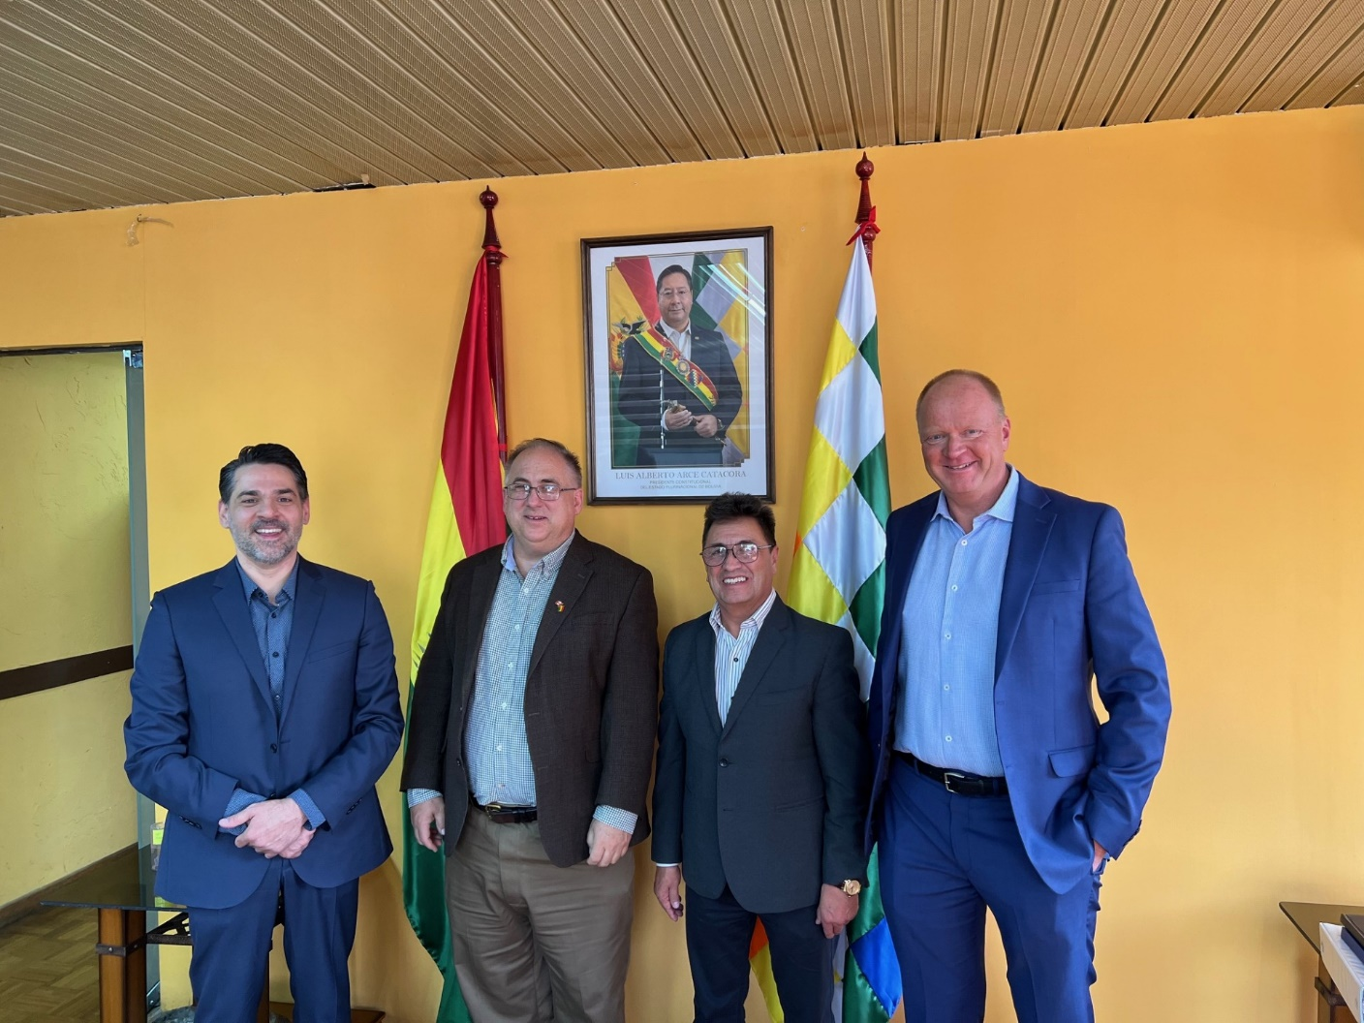
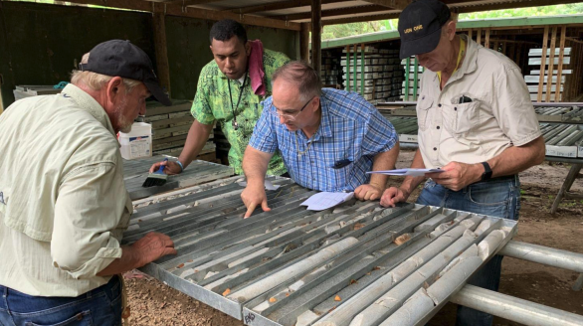
Quinton Hennigh, PhD, with over 40 years of mining experience
Education
M.Sc., Ph.D, Geology & Geochemistry, Colorado School of Mines
B.S., Geology, University of Missouri
Experience
Homestake Mining (acquired by Barrick Gold), Newcrest Mining, Newmont Mining, Gold Canyon Resources, Novo Resources, Eskay Mining, New Found Gold, and San Cristobal Mining.
Advisor to Eric Sprott/Kirkland Lake – Fosterville
Contributed to Significant Gold and Silver Discoveries
Springpole (5.6M oz Au eq.)
N. Leeville (11M oz Au)
Rattlesnake (1.6M oz Au)
Novo’s Beatons Creek (1.0M oz Au) + Pilbara (10M oz Au potential)
Fosterville (3.5M oz high-grade Au)
Eskay Mining (2.5M oz Au eq. potential)
New Found’s Queensway (6M oz high-grade Au potential)
Eloro’s Iska Iska (1B oz Ag eq. potential)
Lion One’s Tuvatu (3.5M oz Au potential)
Snowline’s Valley (14M oz Au potential)
San Cristobal’s Isidorito (1B oz high-grade Ag eq. potential)
Goliath’s Surebet (5M oz Au eq. potential)
6
Crescat Firmwide Presentation
Crescat may or may not have invested in the securities referenced herein. These discoveries are shown to highlight Quinton's career experience. This is not a recommendation or endorsement to buy or sell any security or other financial instrument.

Slide 7
The Lifecycle of a Gold Mine
Crescat Firmwide Presentation

Slide 8
Precious Metals Comparables
Companies shown here were selected based on the following criteria 1) The company was acquired by a mid-tier or major mining company 2) Within 2 years before or after the acquisition, the company had a published resource and/or reserve 3) The company was bought for one specific discovery 4) The first resource and/or reserve update after the acquisition was >1,000,000 Au Equivalent Ounces. Crescat may or may not have held the securities referenced herein. This is not a recommendation or endorsement to buy or sell any security or other financial instrument.
Crescat Firmwide Presentation

Slide 9
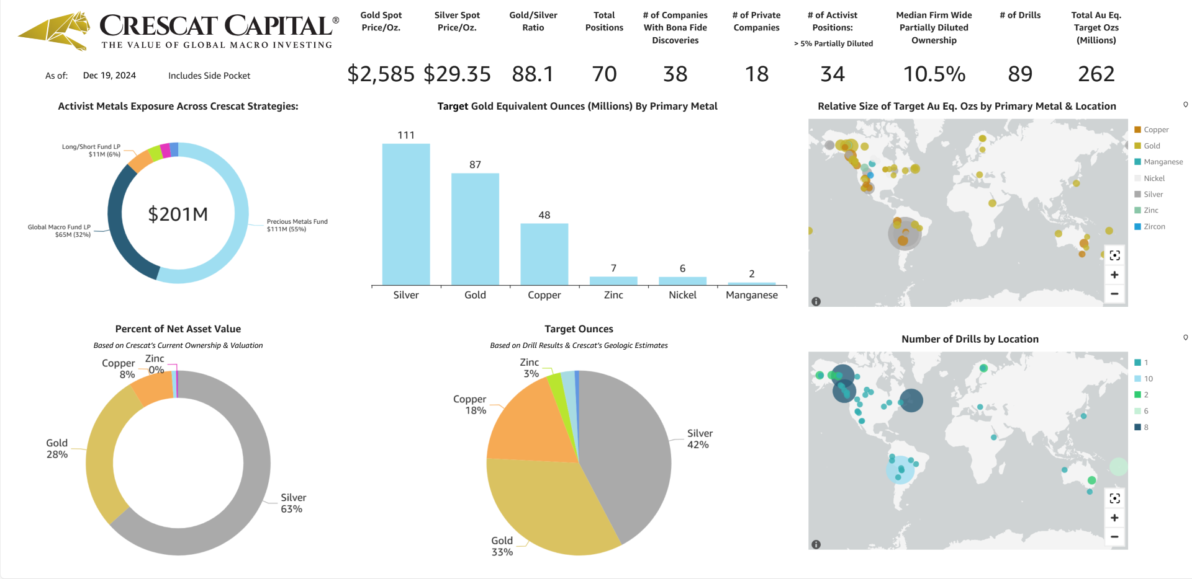
Activist Metals Portfolio Including San Cristobal Side Pocket
The activist metals portfolio subset consists of firmwide holdings across all Crescat funds and SMA accounts in the mining industry where Crescat strives to help companies build economic metal resources through exploration and drilling. Crescat target resource estimates are based on internal modeling and include various assumptions based on analysis of geology, geophysics, geochemistry, historic drill assays, and metallurgical recovery data received to date. Estimates are displayed on a gold equivalent basis based on current price-to-gold ratios for silver, copper, and other metals if the primary metal is other than gold. Further drilling, assaying, resource modeling, and engineering studies will be required to determine whether Crescat’s target resource estimates can be reasonably expected to be achieved. Crescat’s target resource estimates are updated monthly across the entire portfolio. The number of active drills includes those currently in operation doing exploration and/or infill drilling or expected over the next twelve months based on drilling plans and Crescat’s assessment of the company’s ability to finance and execute those plans.

Slide 10
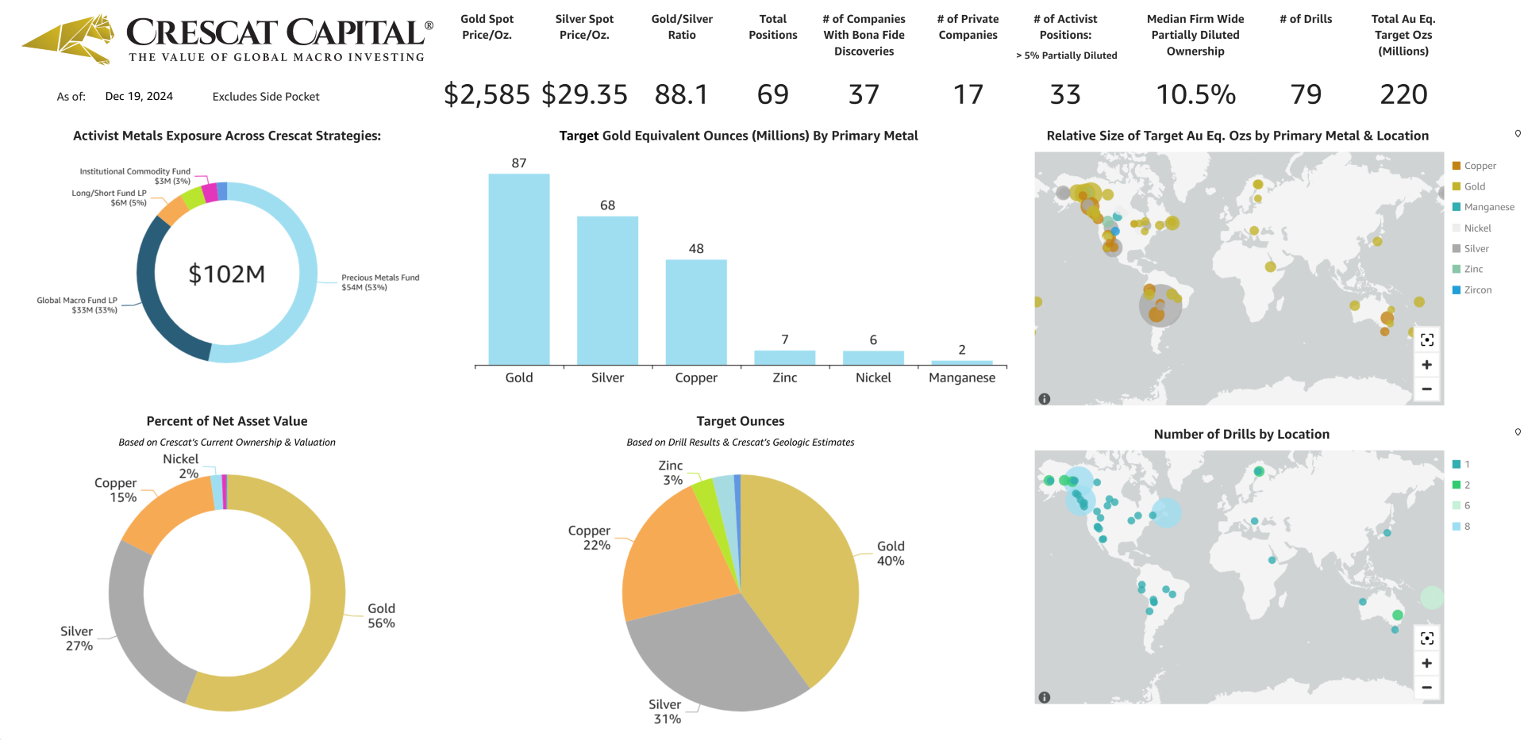
Activist Metals Portfolio Excluding San Cristobal Mining
The activist metals portfolio subset consists of firmwide holdings across all Crescat funds and SMA accounts in the mining industry where Crescat strives to help companies build economic metal resources through exploration and drilling. Crescat target resource estimates are based on internal modeling and include various assumptions based on analysis of geology, geophysics, geochemistry, historic drill assays, and metallurgical recovery data received to date. Estimates are displayed on a gold equivalent basis based on current price-to-gold ratios for silver, copper, and other metals if the primary metal is other than gold. Further drilling, assaying, resource modeling, and engineering studies will be required to determine whether Crescat’s target resource estimates can be reasonably expected to be achieved. Crescat’s target resource estimates are updated monthly across the entire portfolio. The number of active drills includes those currently in operation doing exploration and/or infill drilling or expected over the next twelve months based on drilling plans and Crescat’s assessment of the company’s ability to finance and execute those plans.

Slide 11
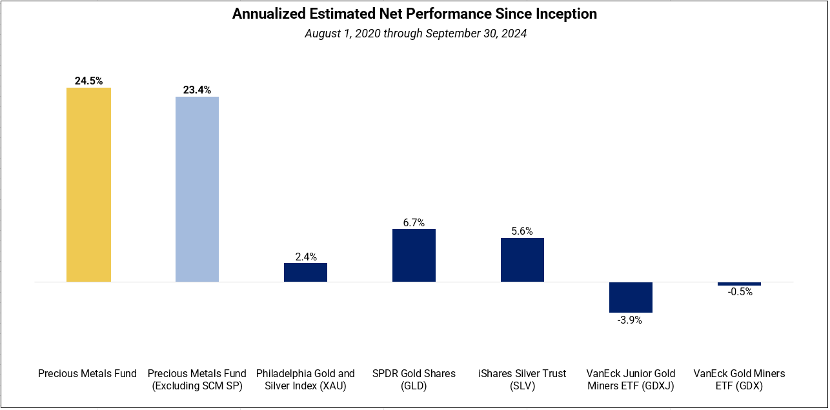
Crescat Precious Metals Fund vs. Benchmarks
Performance data represents past performance, and past performance does not guarantee future results. Performance data is subject to revision following each monthly reconciliation and/or annual audit. Historical net returns reflect the performance of an investor who invested from inception and is eligible to participate in new issues. Net returns reflect the reinvestment of dividends and earnings and the deduction of all fees and expenses (including a management fee and incentive allocation, where applicable). Individual performance may be lower or higher than the performance data presented. Commodity interests trading represents the potential risk of significant losses. The performance of Crescat’s private funds may not be directly comparable to the performance of other private or registered funds.

Slide 12
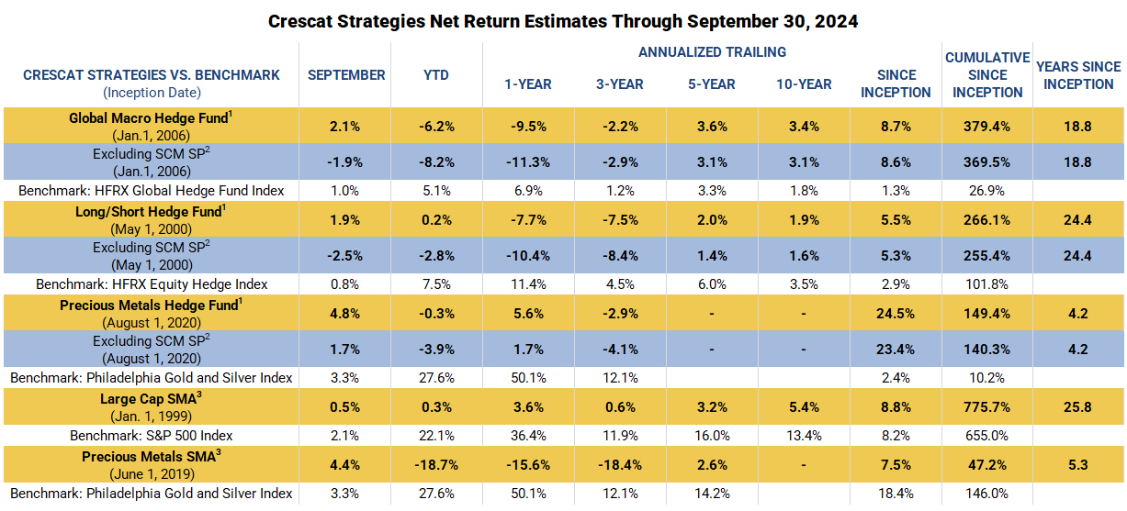
Crescat Performance
Performance data represents past performance, and past performance does not guarantee future results. Performance data is subject to revision following each monthly reconciliation and/or annual audit. Performance which includes periods before January 1, 2003 reflect accounts managed at a predecessor firm. Crescat was not responsible for the management of the assets during the period reflected in those predecessor performance results. We have determined the management of these accounts was sufficiently similar and provides relevant performance information.
1 – Net returns reflect the performance of an investor who invested from inception and is eligible to participate in new issues and side pocket investments. Net returns reflect the reinvestment of dividends and earnings and the deduction of all expenses and fees (including the highest management fee and incentive allocation charged, where applicable). An actual client’s results may vary due to the timing of capital transactions, high watermarks, and performance.
2 – Performance figures presented Excluding SCM SP represent the fund’s net returns calculated without the impact of the San Cristobal Mining, Inc. side pocket that was designated on July 1st, 2024. The side pocket includes a private equity asset that is not available to new investors in the funds on or after July 1, 2024. Excluding these assets provides a clearer view of the performance to investors coming into the funds after that date. New investors cannot participate in the SCM Side Pocket and will not share in its potential gains or losses. Investors should consider both the overall performance and the performance excluding the side pocket when evaluating the fund’s returns.
3 – The SMA composites include all accounts that are managed according to CPM’s precious metals or large cap SMA strategy over which it has full discretion. Investment results shown are for taxable and tax-exempt accounts. Any possible tax liabilities incurred by the taxable accounts are not reflected in net performance. Performance results are time weighted and reflect the deduction of advisory fees, brokerage commissions, and other expenses that a client would have paid, and includes the reinvestment of dividends and other earnings.
Crescat Firmwide Presentation

Slide 13
Fees, Breakpoints & Terms
Global Macro and Precious Metals Funds
A 3-Year partial lock up applies to all classes of Crescat’s Global Macro and Precious Metals funds.
With 90-day notice, LPs may redeem up to 25% of capital account any month after year 1, up to another 25% after year 2, and all after year 3.
Long/Short Fund
A 3-Year partial lock up applies to Crescat’s Long/Short fund.
With 90-day notice, LPs may redeem up to 25% of capital account any month after year 1, up to another 25% after year 2, and all after year 3.
Crescat Firmwide Presentation

Slide 14
Contact Information:
Marek Iwahashi
Head of Investor Relations
(720) 323-2995 | miwahashi@crescat.net
Follow us on:
YouTube: @Crescatcapital3641
Twitter: @Crescat_Capital
Visit our Website and Subscribe to our Investor Letters:
www.crescat.net

Slide 15
Appendix
Crescat Firmwide Presentation

Slide 16
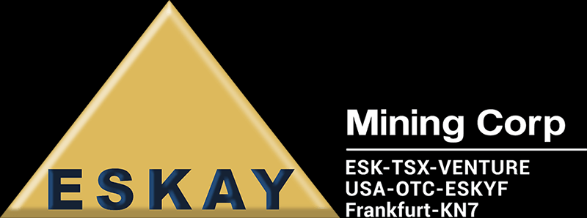
Crescat’s Top 10 Activist Metals Holdings as % of Firm NAV As of October 19, 2024
1
San Cristobal Mining (Private)*
6
Western Alaska Minerals ($WAM.V)
2
Snowline Gold ($SGD.CF)
7
Blackjack Silver Corp. (Private)
3
Goliath Resources ($GOT.V)
8
Eskay Mining ($ESK.V)
4
Eloro Resources ($ELO.V)
9
Brixton Metals ($BBB.V)
5
Sitka Gold ($SIG.V)
10
Altamira Gold ($ALTA.V)
Activist metals portfolio includes the San Cristobal Mining, Inc. equity asset that was designated into a side pocket on July 1st, 2024. The side pocket includes an asset that is not available to new investors in the funds after July 1, 2024. New investors cannot participate in the SCM Side Pocket and will not share in its potential gains or losses. The securities shown herein are the top ten activist metals holdings across all Crescat funds and separately managed accounts as the date shown above. The top ten are subject to change at any time without notice. The definition of the activist metals portfolio is provided above. These holdings do not represent an entire portfolio. While these are the top ten activist metals positions firmwide, they may not represent the top ten securities for any particular fund or SMA strategy. This presentation is not intended to be, nor should it be construed as, an offer to sell or a solicitation of an offer to buy any security.
16

Slide 17
What Activist Metals Investing Means for Crescat
Identify large-scale gold, silver, and copper and other critical metal discovery targets in viable mining jurisdictions
Acquire significant early-stage stakes at low valuations through PIPEs and pre-IPO rounds
Inject capital into companies for exploration, drilling, and development work
Provide activist-oriented geologic and technical advice
Help place management and directors, including a Crescat director in select cases
Help build geologic and technical team
Share the story with the investment community
Crescat Firmwide Presentation

Slide 18
Gold Explorer Historic Acquisition Data and Notes
Companies shown here were selected based on the following criteria 1) The company was acquired by a mid-tier or major mining company 2) Within 2 years before or after the acquisition, the company had a published resource and/or reserve 3) The company was bought for one specific discovery 4) The first resource and/or reserve update after the acquisition was >1,000,000 Au Equivalent Ounces. Crescat may or may not have held the securities referenced herein. This is not a recommendation or endorsement to buy or sell any security or other financial instrument.
Precious Metals Presentation

Slide 19
Global Macro Portfolio Exposure By Theme Including San Cristobal Side Pocket
For options positions, exposures are based on delta notional values.
Through October 19, 2024
See slide in appendix where more details on themes is present.
Crescat Firmwide Presentation

Slide 20
Global Macro Portfolio Exposure By Theme Excluding San Cristobal Side Pocket
For options positions, exposures are based on delta notional values.
Through October 19, 2024
See slide in appendix where more details on themes is present.
Crescat Firmwide Presentation

Slide 21
As value investors, we are comfortable accepting a moderate amount of risk in order to realize the strong returns that are possible from our macro themes and valuation models over complete business cycles.
Our investment principles and models give us the confidence that the intrinsic value of our portfolios is substantially greater than the current market price at any given time. As such, we believe pullbacks in Crescat’s strategies offer great opportunities for both new and existing investors to deploy capital.
Risk Management
Process and Philosophy
Crescat believes in portfolio diversification across securities and among independent, non-correlated macroeconomic themes which can be accomplished by various combinations across the firm’s investment strategies to tailor to individual client needs, objectives, and risk tolerance.
Individual position sizing is a function of investment team conviction, security-specific volatility, correlation with other securities in the existing portfolio, and contribution to theme-level and overall portfolio risk.
We view market volatility as our friend to help us initiate long positions cheaply and short positions dearly and ultimately deliver strong appreciation.
Clients desiring less volatility can make a lesser relative allocation to Crescat’s strategies and can combine Crescat’s strategies with cash and short-term fixed income investments to reduce risk.
Clients need to be able to embrace a mindset that short-term pullbacks in Crescat’s strategies are not a permanent loss of capital or our strategies will not likely be suitable for them.
Strategies are actively managed and subject to change

Slide 22
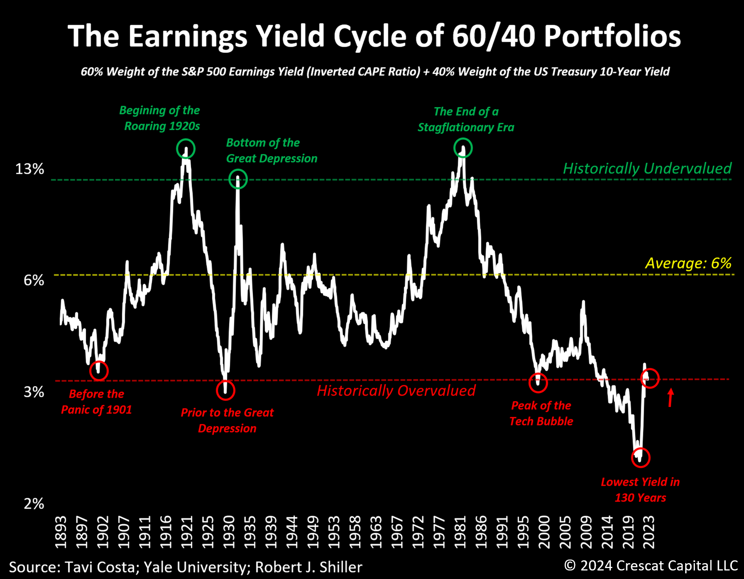
The valuation history of 60/40 portfolios unfolds through extended cycles, and we are currently experiencing another critical juncture in this dynamic.
Crescat Firmwide Presentation

Slide 23
We believe treasuries are no longer acting as a hedge against stocks.
Crescat Firmwide Presentation

Slide 24
Treasuries may no longer be the safest alternative.
Crescat Firmwide Presentation

Slide 25
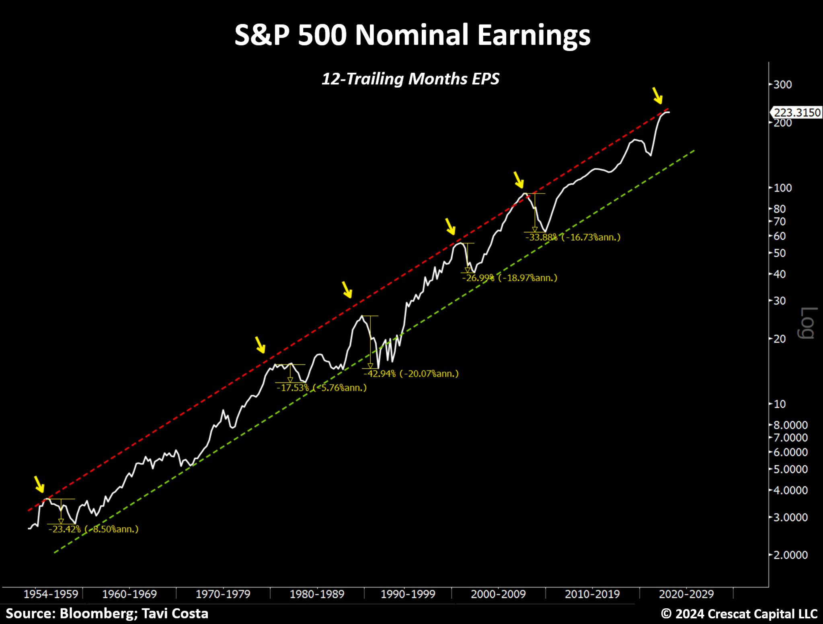
Nominal corporate earnings have been trending in an upward channel for 70 years. Every time profits reached the upper band of this range, an earnings recession followed. We are at a similar peak-level juncture again today while analysts continue to be overly optimistic.
Crescat Firmwide Presentation

Slide 26
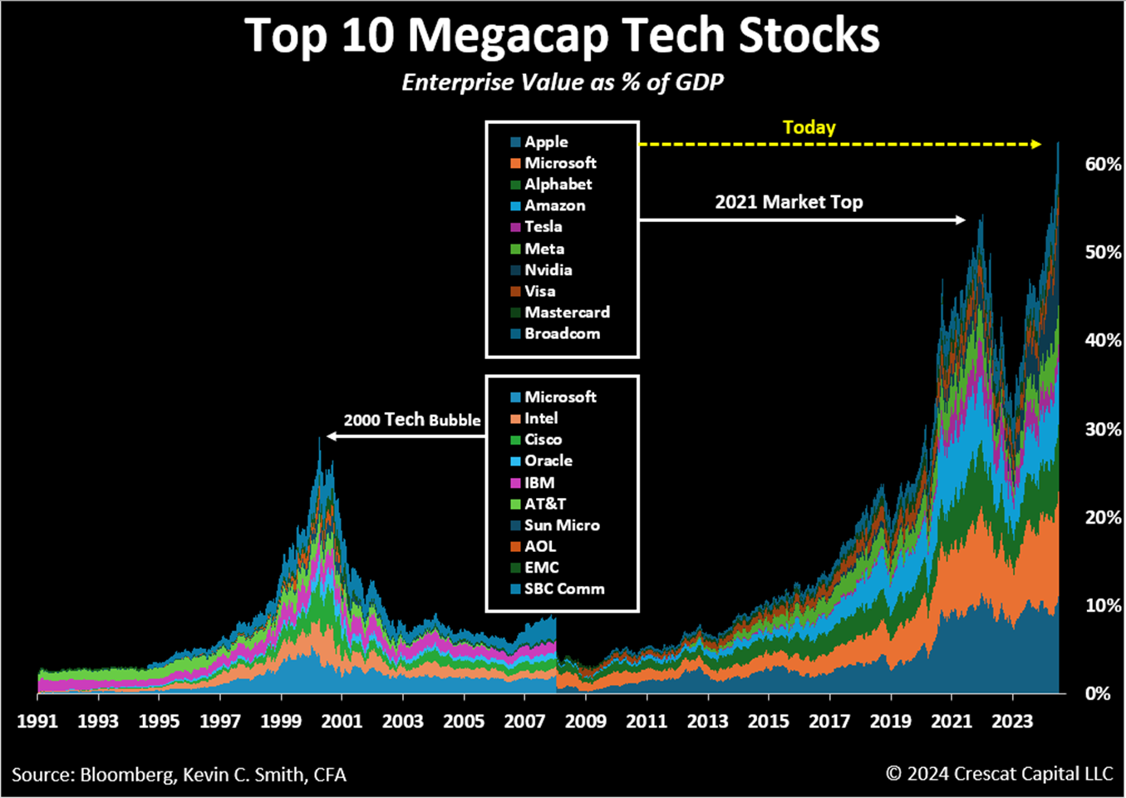
Valuations for the top-ten megacap tech stocks are still higher than their counterparts at the peak of the 2000 tech bubble.
A recession is still pending based on our research. The next leg down is likely to be severe.
Crescat Firmwide Presentation

Slide 27
The percentage of inversions in the US Treasury yield curve has breached the critical 70% level. As our research shows, every breach of this threshold in the history of the data back to 1970 has led to a near-term recession.
Crescat Firmwide Presentation

Slide 28
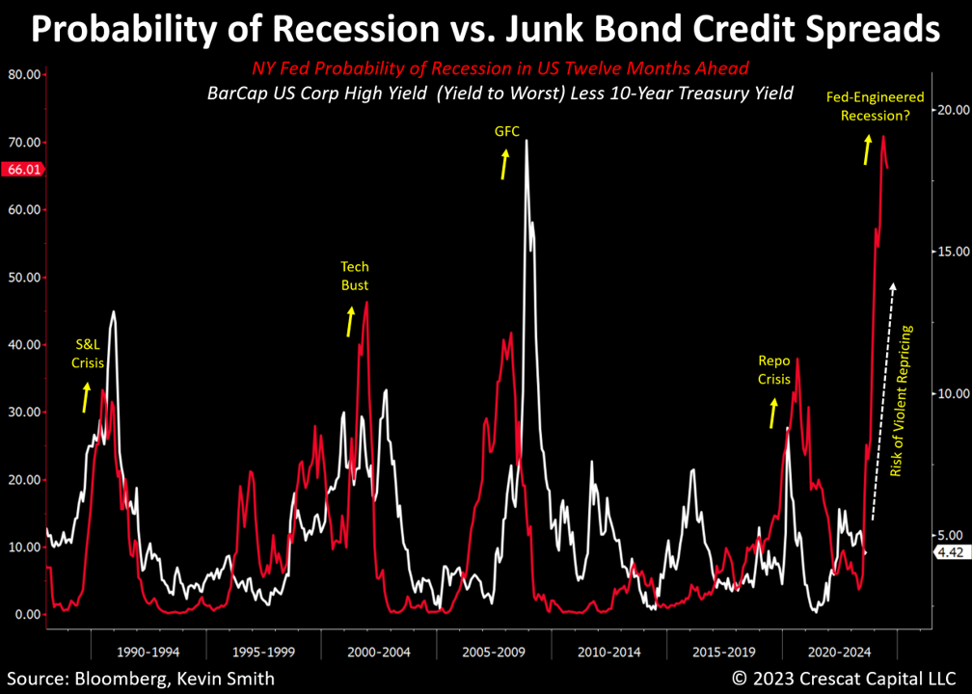
The Fed’s yield curve model warns of recession. Junk bonds are likely one of the next shoes to drop.
Crescat Firmwide Presentation

Slide 29
If the rationale for buying Treasuries is solely based on the premise that the system cannot endure substantially higher interest rates, then gold would be a far superior choice.
Crescat Firmwide Presentation

Slide 30
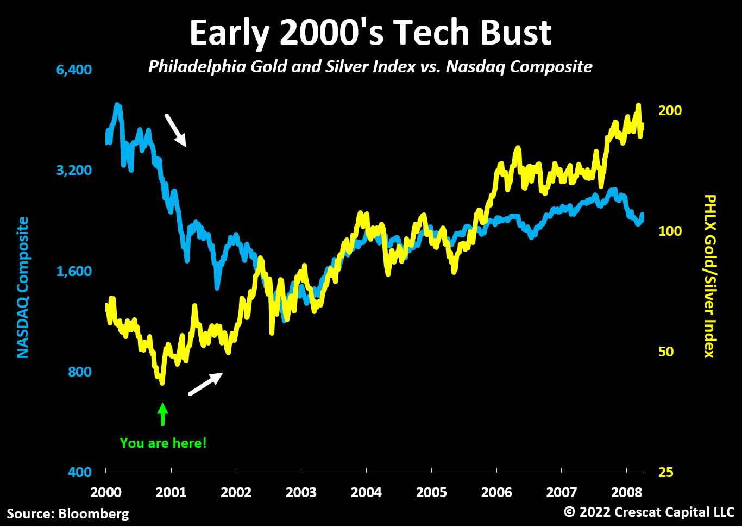
In the early 2000’s tech bust, NASDAQ continued to fall all the way to October 2002, but the great buying opportunity for precious metals mining stocks started at the end of 2000.
Crescat Firmwide Presentation

Slide 31
In 1973 to 1974, mining stocks went up 5-fold in just two years while the S&P 500 declined 50%. Large-cap growth stocks known as the Nifty Fifty at the time, the mega-caps of their day, went down substantially more.
Crescat Firmwide Presentation

Slide 32
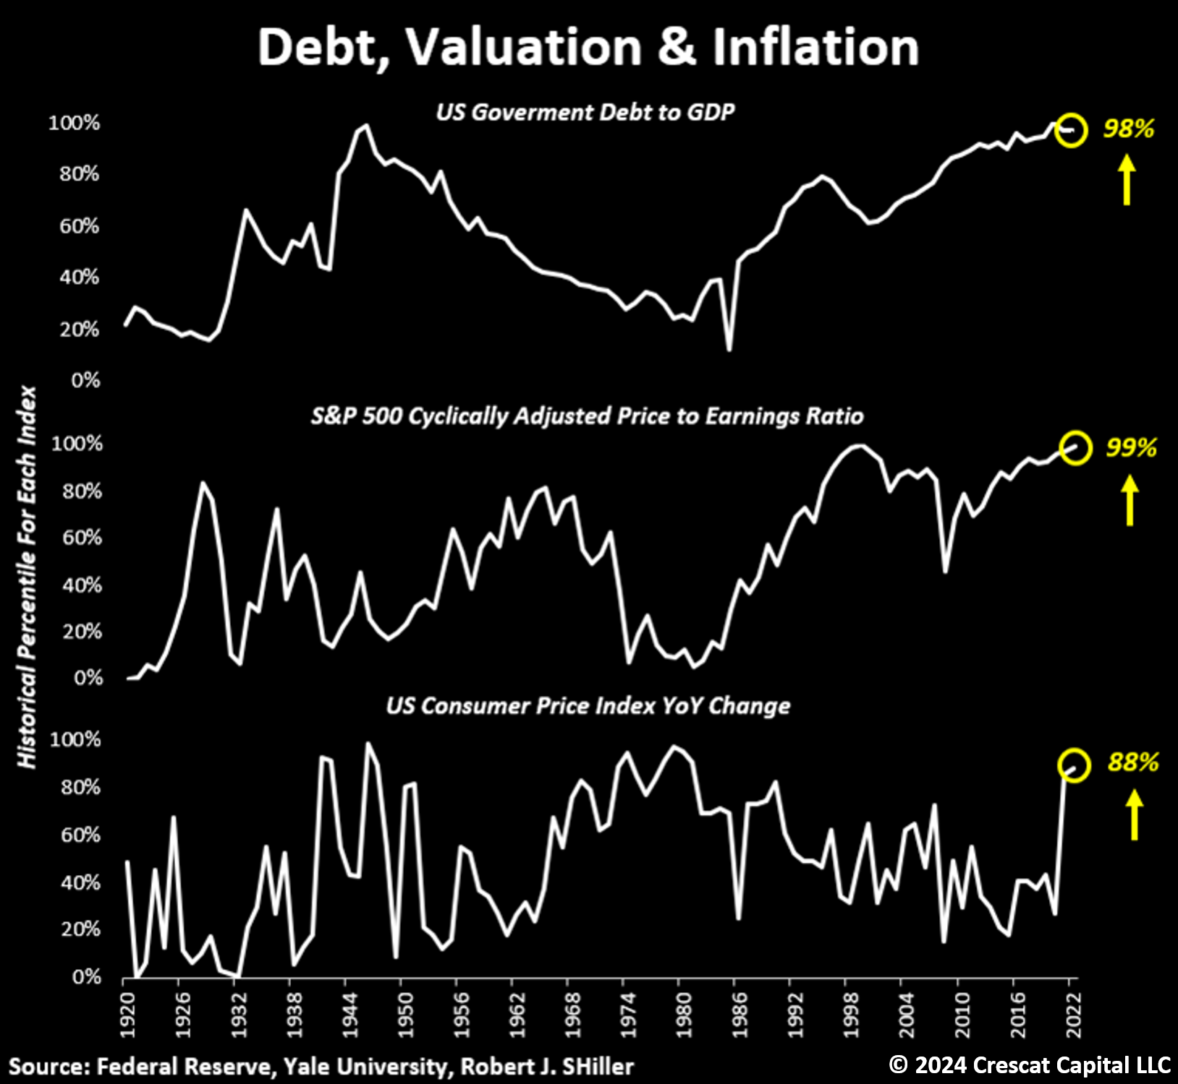
The trifecta of macro imbalances. For the first time in history, the US is experiencing a confluence of three macro extremes.
Crescat Firmwide Presentation

Slide 33
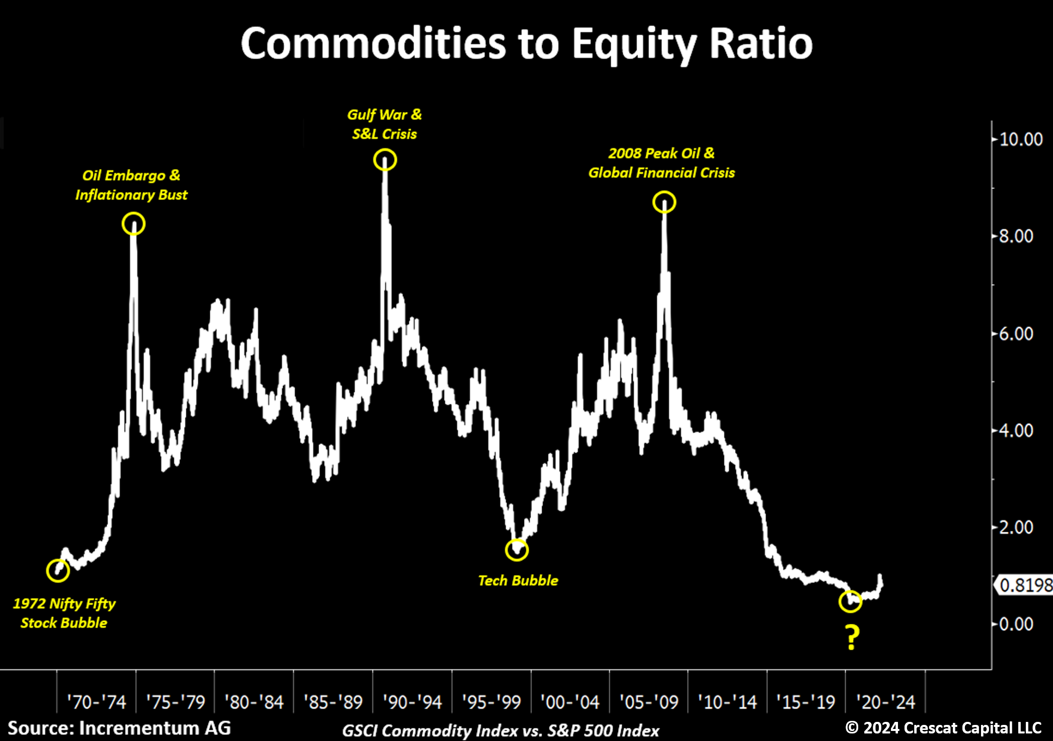
The commodity-to-equity ratio is a setup like the early 1970s and early 2000s but from an even bigger imbalance.
Crescat Firmwide Presentation

Slide 34
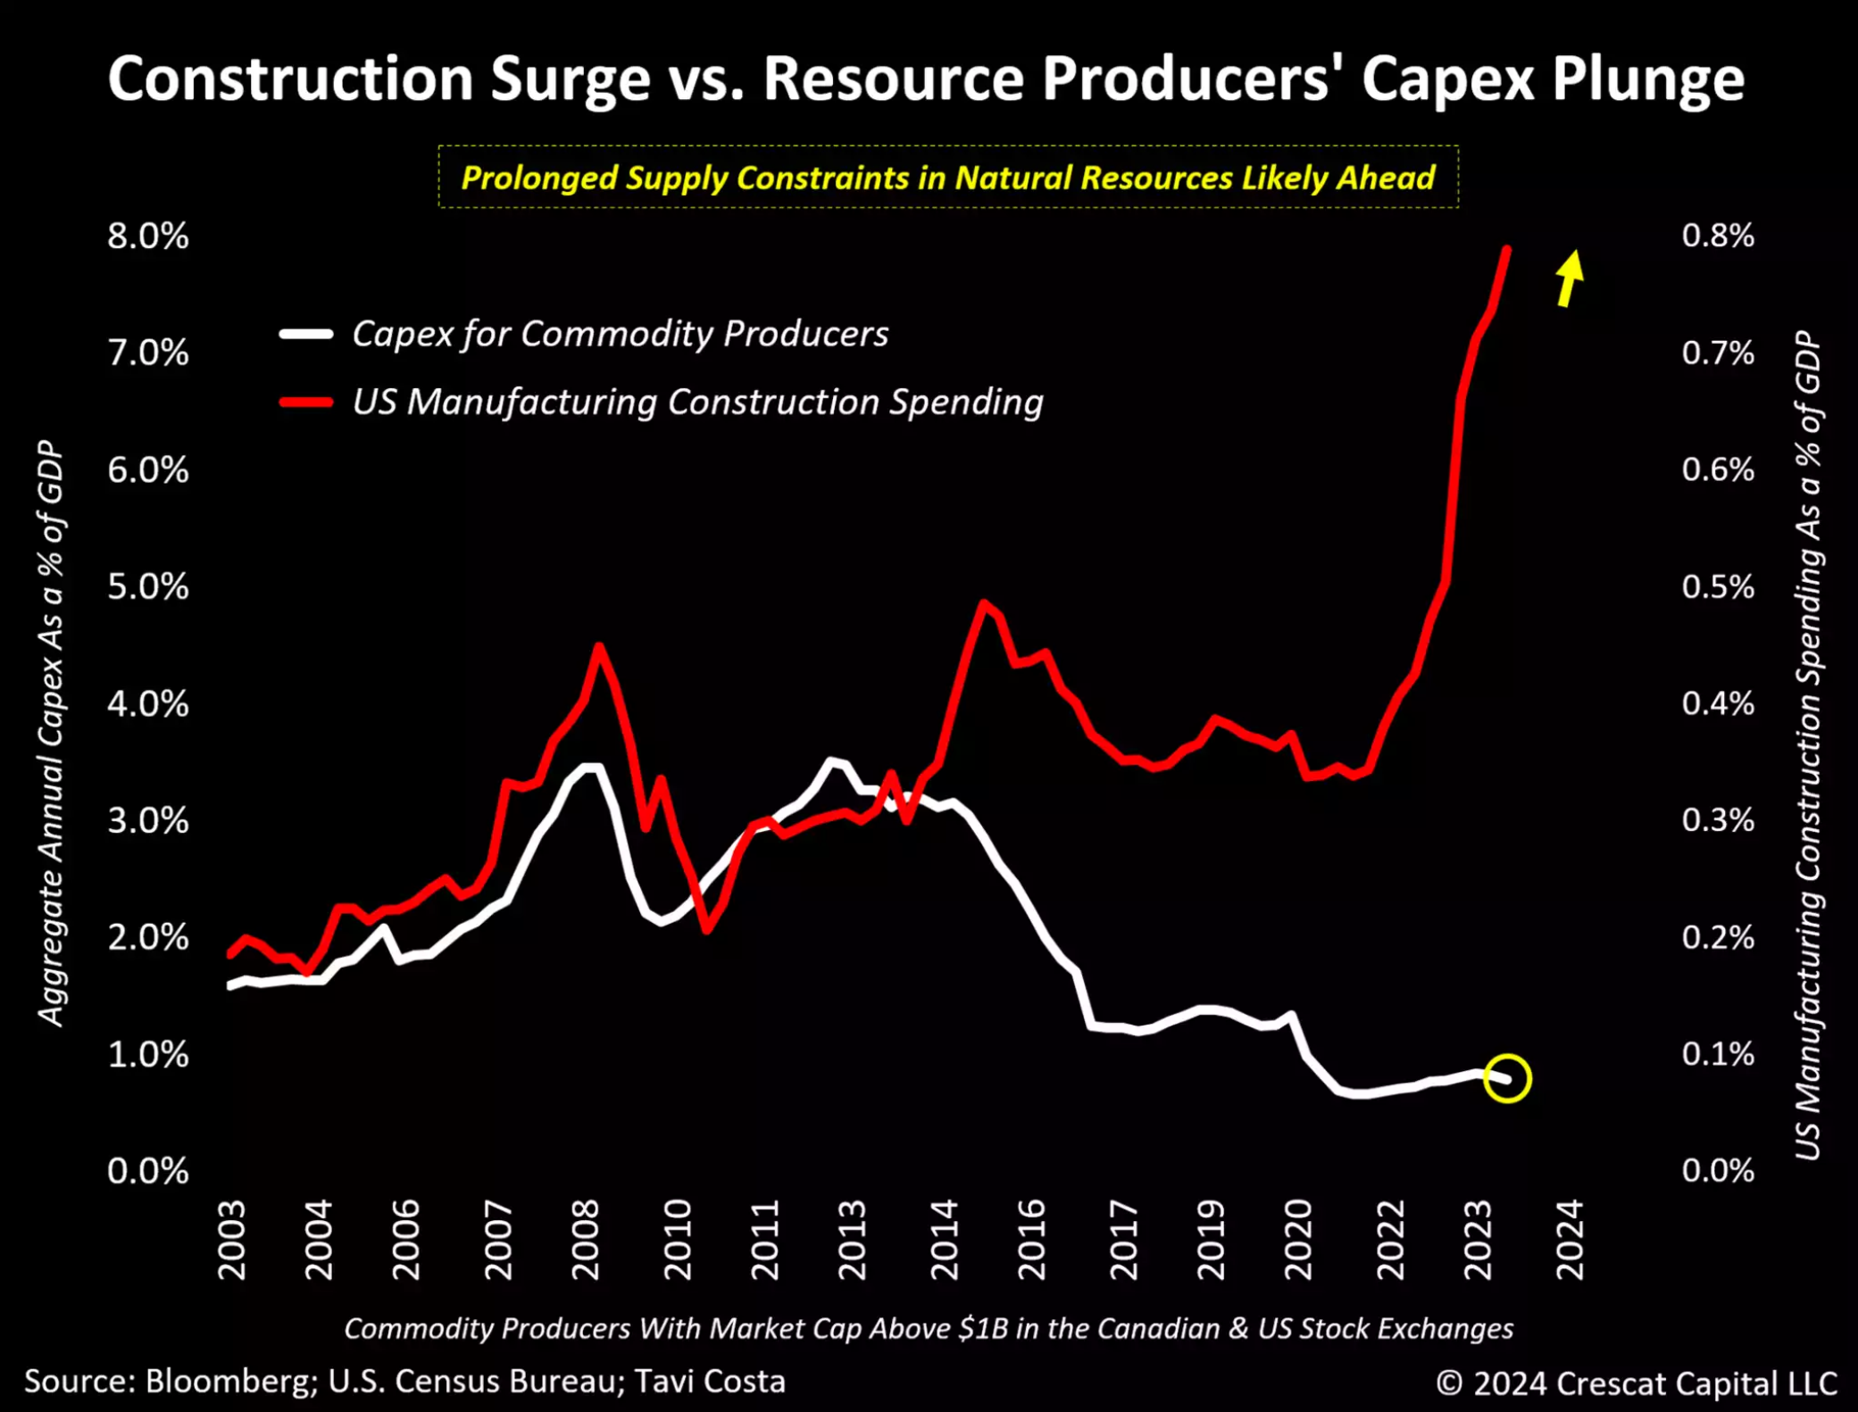
Today’s predicament lies in the fact that despite the recent upsurge in construction spending, especially for manufacturing, commodity producers have evidently fallen short of matching this trend.
Crescat Firmwide Presentation

Slide 35
We are currently experiencing the most aggressive infrastructure spending of the past century.
Excessive levels of debt often precipitate escalating geopolitical tensions and conflicts, and as disagreements among nations intensify, there arises a greater imperative for countries to bolster their self-reliance on domestic operations.
Crescat Firmwide Presentation

Slide 36
The metals and mining industry as part of the overall stock market is almost a rounding error.
We believe this industry will likely become a significantly larger segment of the market by the end of this decade.
Crescat Firmwide Presentation

Slide 37
Multi-year periods of declining production also marked secular bull markets for gold prices.
Crescat Firmwide Presentation

Slide 38
The TSX-V hit its all-time high in 2007. Gold has been hitting new all-time highs while the TSX-V has been depressed. The value opportunity in junior mining companies is extraordinary.
Why are the TSX Venture Composite Index and the TSX-V Exchange in Canada relevant proxies for exploration-focused mining stocks? The TSX Venture Composite Index is one of the longest-running indices with a heavy concentration of mining exploration stocks. As of 4/19/24, there were 127 companies in the TSX Venture Composite Index. Their average market cap was USD 270 million. 85 of these companies or 67% of them are in the mining & metals industry and had an average market cap of USD 183 million. The index is a subset of the broader TSX Venture Composite Exchange which has a total of 1,891 companies listed on it with an average market cap of USD 35 million. To be included in the TSX-V Composite Index, a security must have a relative weight of at least 0.20% of the total capitalization of the TSX-V Exchange. 967 of the companies on the overall TSX-V Exchange or 51% of them are in the mining and metals industry with an average market cap of USD 29M. The mining companies listed on the TSX-V Exchange are almost all exploration-focused miners, a large universe of publicly traded companies for Crescat to consider for its exploration-focused activist metals and mining investment theme. TSX-V mining companies tend to be explorers because once these firms become more advanced and go into development or production, if not bought out by a larger firm first, they will typically move their listing up to the TSX big board.
Crescat Firmwide Presentation

Slide 39
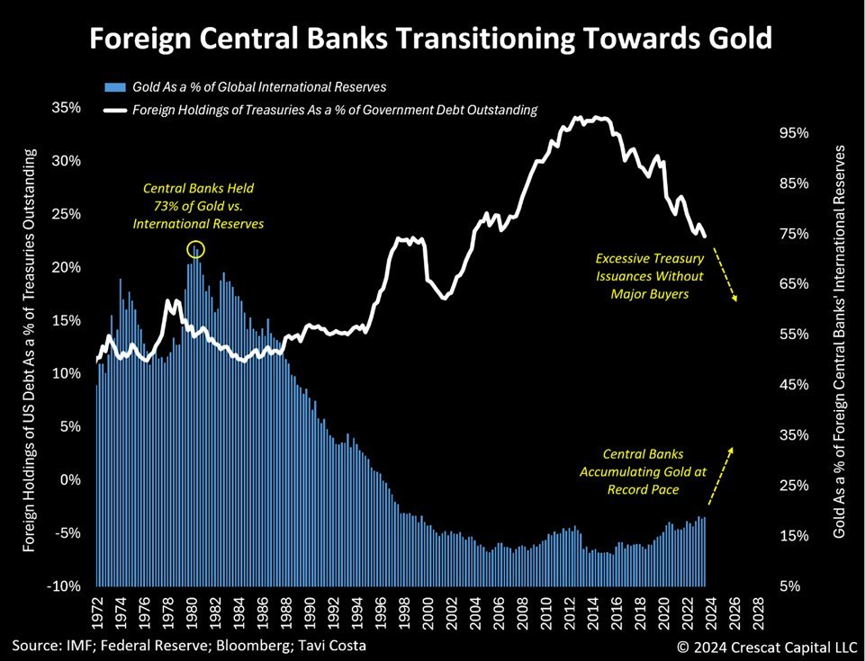
Gold’s role as a universal, neutral asset with millennia of history as money, is experiencing a resurgence relative to US Treasuries for global central bank reserve accumulations.
Crescat Firmwide Presentation

Slide 40
The multitude of macro drivers supporting the onset of another gold cycle is truly remarkable.
Crescat Firmwide Presentation

Slide 41
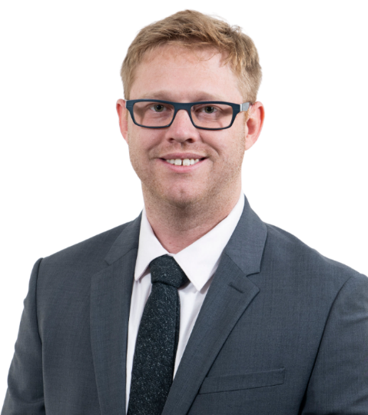
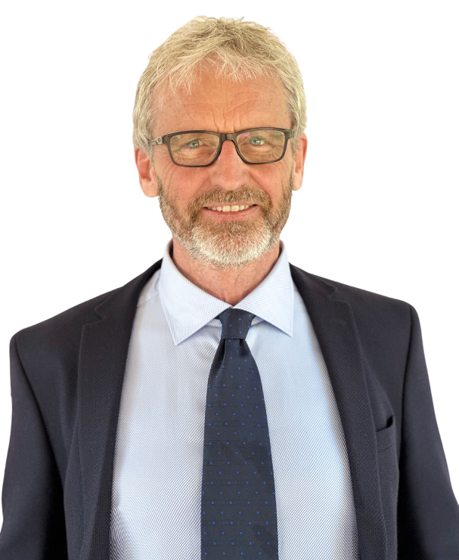
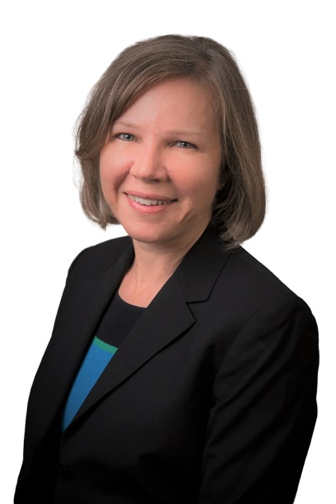
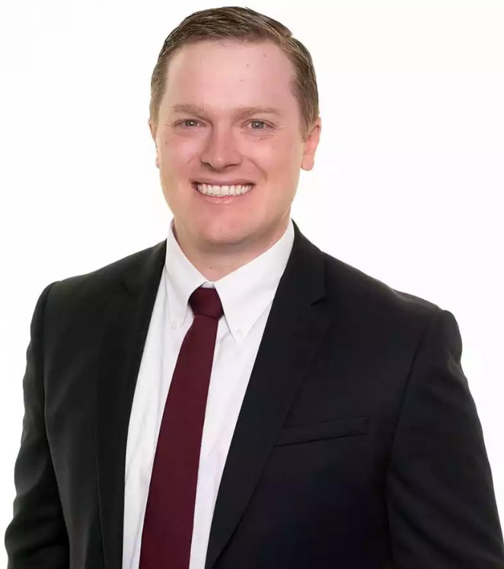
Team Bios
Ryan Wardell
Investment Systems Leader
Lars Theill, PhD
Senior Biopharma Advisor
Lisa Thieme
Senior Energy Advisor
Tyler Reger
Fund Controller
Ryan is responsible for the firm’s investment management operations and trading, including trade staging and execution. He is also responsible for maintaining the firm’s portfolio track records and internal systems, including the automation and production of its equity and macro models. Ryan came to Crescat with more than 10 years of industry experience as Specialized Services Trader at Scottrade and Fidelity Investments. He earned a Bachelor of Science in Business Administration from Old Dominion University in Norfolk, Virginia. Ryan is currently working towards the Chartered Financial Analyst designation and has passed the CFA Level 1 Exam.
Lars is a scientist, inventor, and entrepreneur with 30+ years of biomedical research and drug discovery experience. After earning a PhD in Molecular Biology from Aarhus University, a Medicinal Chemistry degree, and postdoctoral training at UC San Diego Medical School, Dr. Theill lead a biotherapeutics discovery laboratory at Amgen for 15 years, contributing to the invention and preclinical development of numerous small molecule and protein-based therapeutic candidates (including the now blockbuster Prolia) for treatment of cancer, inflammation, and neurodegenerative diseases. In parallel, he evaluated countless in-licensing and acquisition opportunities for the Amgen business development team. Lars is a founder and President of Logix Pharmaceuticals Inc., engaged in developing kinase inhibitors for treatment of cancer, and performing biotech equity research for institutional investors. Dr. Theill is an inventor and author on multiple US patents and 28 research articles published in Science, Nature, Cell, and other leading scientific journals. These papers have received >5,100 citations.
Lisa Thieme provides guidance in the Energy sector with a focus on the petroleum industry. Lisa has spent 27 years in the Energy and Mining industries, including 20 years with Shell in Exploration, Development and Carbon Sequestration/New Energies groups. She has played a key role in Eastern Gulf of Mexico oil discoveries and gas discoveries in Asia. Within Shell, she was an Operations Geology Subject Matter Expert. The first seven years of her career was in the mining industry with Phelps Dodge and Placer Dome primarily exploring for gold, copper and zinc. She has worked across the globe in South America, North America, Asia, Australia and Europe. Her M.S. is from Colorado School of Mines with a B.A. in both economics and geology from Lawrence University.
Tyler oversees the financial accounting and reporting of Crescat’s hedge funds. He acts as the primary liaison between the prime brokers, administrator, and investment team to ensure that all parties are in sync to provide accurate and timely reporting. Tyler came to Crescat with 11 years of industry experience in fund administration. Prior to joining Crescat, Tyler held positions in mutual fund and private equity administration at STRAIT Capital, Charles Schwab Investment Management and ALPS Fund Services. He earned a Bachelor of Science in Business Administration with and emphasis in Accounting from the University of Colorado, Leeds School of Business and a Master of Science in Accounting from the University of Colorado, Denver.
Crescat Firmwide Presentation

Slide 42
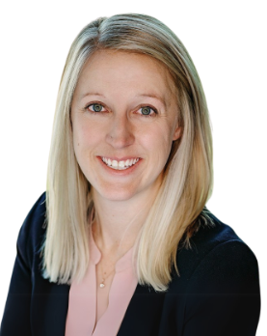
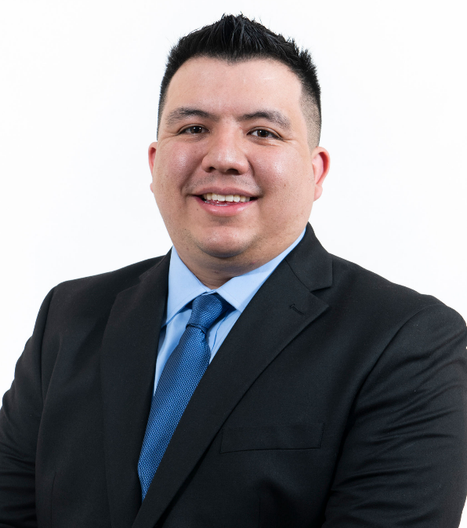
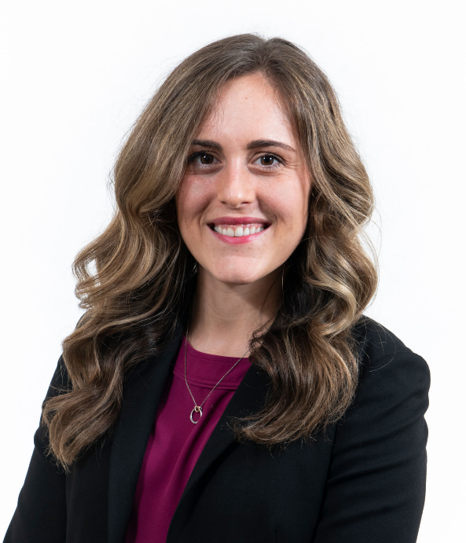
Team Bios
Danielle Money
Chief Compliance Officer
Marek Iwahashi
Head of Investor Relations
Cassie Fischer
Head of Marketing Communications
Danielle is responsible for overseeing Crescat's compliance program as Chief Compliance Officer, ensuring that the firm consistently meets regulatory requirements and upholds the highest standards of compliance. Danielle joined the firm with over 13 years of experience and is the proud owner of an I Heart Compliance mug. She previously served as the Compliance Officer at Paradice Investment Management and held key compliance leadership roles as Director of Compliance at PINE Advisor Solutions and Compliance Manager at ALPS Fund Services. Danielle holds a Master of Legal Studies from Washington University in St. Louis and a Bachelor's degree from the University of Colorado. She is also a Certified Anti-Money Laundering Specialist (CAMS).
Marek is Crescat’s point person for existing and prospective investors. With a strong background in finance, he works with clients to understand their needs, explain the firm’s strategies, open new accounts, and respond to inquiries. Marek also handles various operations, including performing daily trade reconciliation and settlement. He helps produce firm marketing materials, updates consultant databases, and assists the investment team. Marek stood out versus his peers by making strong grades in an accelerated degree program at the University of Colorado, Denver where he earned a Bachelor of Science degree in Accounting and Finance and an MBA with a specialization in Finance in 2019 while working full time. Prior to joining Crescat, he worked as a Mutual Fund Analyst at Broadridge Financial Solutions and assistant branch manager at TCF National Bank.
With a background in both finance and marketing, Cassie strives to perfect the Crescat client journey. She is focused on transparent and engaging communication of Crescat’s investment themes and strategies to distinguish the Crescat brand. Cassie has a lead role in crafting the firm’s marketing materials from strategy presentations to client reports, email communications, website, and social media content. She also works as a Client Services Specialist to help existing and prospective investors refine their investment goals and better understand Crescat’s offerings while answering any questions that may arise throughout the process. Additionally, Cassie is the point person for investment consultants and their databases. Cassie graduated cum laude from Virginia Polytechnic State University with a B.S in Finance. Prior to joining Crescat, she worked as a Marketing Strategist for DISH Network in Englewood, CO.
Crescat Firmwide Presentation

Slide 43
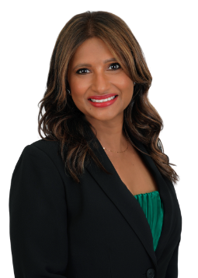
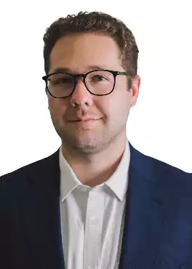
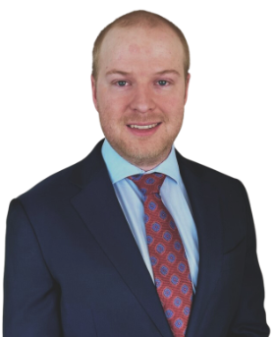
Team Bios
Ravena Khan
Assistant Controller
Nathaniel Gilbert
Analyst and Assistant Portfolio Manager
Trevor Smith
Data Scientist
Ravena is responsible for the daily function in maintaining parallel records to the fund’s administrator and prime brokers. She is also responsible for assisting in the review of monthly reporting and client statements. Ravena came to Crescat with over 20 years of experience in the hedge fund industry. Her previous roles include serving as a Controller at Foxhill Capital Partners for 13 years and Gracie Capital for 5 years, where she gained invaluable expertise in fund accounting and reporting. Ravena is magna cum laude graduate of Berkeley College in New York, where she earned her accounting degree.
Nathaniel handles various day-to-day and operational tasks for the Chief Investment Officer. In addition, he helps to maintain and expand Crescat’s proprietary models and assists the investment team with research and trading. Nathaniel joined Crescat in 2022 after graduating from the University of Colorado Boulder with a bachelor’s degree in Economics and a minor in Business and Financial Analytics.
Trevor serves as Crescat’s Data Scientist. The exciting developments in the world of Artificial Intelligence have provided Crescat with the opportunity to harness the power of Machine Learning, Natural Language Processing, and Data Analytics to advance our quantitative analysis to new heights. With prior work experience in the Applied Math Department and degrees in Statistics & Data Science and Economics from CU Boulder, Trevor works to both develop new financial models and improve existing ones in order to maximize Crescat’s quant research capabilities. Trevor also uses his statistical knowledge to provide day-to-day research and trading ideas. With AI suddenly exploding into the industry, Trevor helps keep Crescat ahead of the curve.
Crescat Firmwide Presentation

Slide 44
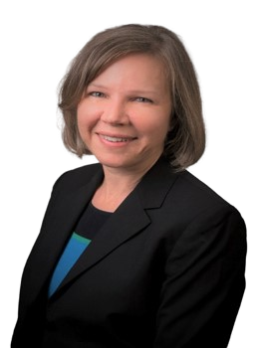
Crescat’s Industry Experts: Oil & Gas
Lisa Thieme, Senior Energy Advisor
M.S., Colorado School of Mines
B.S., Lawrence University
27 years of industry experience.
Worked for Shell for 20 years in Exploration, Development, and Carbon Sequestration/New Energies groups.
Played a key role in Eastern Gulf of Mexico oil discoveries and Gas discoveries in Asia.
44

Slide 45
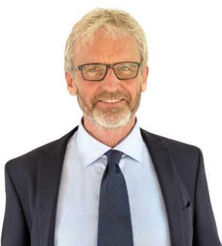
Crescat’s Industry Experts: Biotech
Lars Thiell, PhD, Senior Biopharma Advisor
PhD, Aarhus University
Medicinal Chemistry Degree, UC San Diego
30+ years of biomedical research and drug discovery experience.
Lead biotherapeutics discoveries lab at Amgen for 15 years, contributing to the development of numerous small molecule and protein-based therapeutic candidates (including Prolia) for treatment of cancer, inflammation, and neurodegenerative diseases.
45

Slide 46
2006-2008
The U.S. Housing & Mortgage Bust
2018
Equity & Credit Market Downturn
Emerging Market Contagion
2007-2008
Oil Bull Market (Peak Oil)
Global Financial Crisis
2020
Global Economic Recession
March Equity Dislocation
Global Fiat Debasement
History of
Successful Themes
2006-2010
Precious Metals Bull Market
2014
Oil Price Collapse
2021
Resource Underinvestment
Energy Shortage
Crescat’s investment process has led us to successfully capitalize on many major economic themes
2014-2015
Biotech Run-up & Bust
2022
Megacap Growth Ceiling
SaaS Rationalization
Electrification Metals
Energy Shortage
Yuan Devaluation
2014-2017
Rise of Artificial Intelligence
Please refer to the performance slide of this presentation deck for the full performance history.
2014-2019
Yuan Devaluation
2015
China Credit Bust
2023
Electrification Metals
Genomic Revolution
2016-2018
Demand for Cybersecurity
46
Crescat Firmwide Presentation

Slide 47
2011-2015
Global Fiat Debasement
After profiting from this long precious metals theme in the 2000s, we stuck with it based on our belief that increasing government debt, deficits, and money printing in the wake of the GFC would lead to substantial inflation. Instead of creating inflation, the money printing led to bubbles in financial assets relative to commodities that have continued to this day. Inflation took much longer than we ever imagined to play out. So, in 2020, we partnered with an industry expert and started building an activist precious metals mining portfolio to take advantage of the industry depression and deep undervaluation. Since then, this gold-focused theme and its sister theme, Electrification Metals, have had outstanding absolute and relative performance. Lesson: If life gives you lemons, make lemonade. Never give up on a great idea. Now rising inflation is finally here and proving to be intractable. We believe our fortitude has allowed us to be well positioned in a deeply undervalued portfolio of some of the biggest new economically viable metal discoveries on the planet for a likely upcoming precious metals and commodity bull market.
Lessons From
Unsuccessful Themes
2020-2021
SaaS Rationalization
In our Global Macro and Long/Short funds, we took a contrary position by shorting popular software-as-a-service stocks that were highly overvalued based on our fundamental equity model. This hurt us as valuations went from excessive to ultra-excessive under the Covid stimulus. Many of the stocks we shorted worked spectacularly in late 2021 and 2022, but we did not benefit as much as we could after shrinking our exposure due to the trauma of being too early. Lesson: Don’t underestimate the ability of overvalued stocks to get more overvalued when the fiscal and monetary stimulus is flowing and animal spirits are running high, but don’t be afraid to stick with a good short theme either just because it burned you at one time in the past.
However, Crescat's investment process has also led the firm to pursue certain themes that at times proved unsuccessful.
Please refer to the performance slide of this presentation deck for the full performance history.
2023
Megacap Growth Ceiling
After performing well with this short theme in 2022 in our Global Macro and Long/Short funds to deliver positive returns and strong alpha in a down market, we overstayed our welcome in 2023. We thought the tech bubble was bursting much like from 2000-2002, but unlike then, growth in 2023 reaccelerated driven by breakthroughs in generative AI and the corresponding spending frenzy. Lesson: Growth inflections can be tricky. Pay close attention to the calculus of recent and near-term expected sales, earnings, and free cash flow growth. The problem of historically high market share and enterprise value to GDP, however, remain impediments to sustained high growth for megacap tech, so we stuck with this theme with intermittent success to date in 2024 as growth is now decelerating while antitrust action, tech disruption, geopolitical threats, and potential recession are looming. We believe this theme remains highly relevant and timely.
47
Crescat Firmwide Presentation

Slide 48
Firm History
Predecessor Firm
Crescat Capital LLC
Kevin & Linda Smith Start Careers with Kidder, Peabody
Crescat Formation & Global Macro HF Launch
GM HF Absolute Return Awards Fund of the Year
Large Cap SMA Inception
Tavi Costa Joins Crescat
GM & LS 2 of Bloomberg’s
Top 3 HFs
Precious Metals HF Launch
1992
1999
2006
2013
2015
2018
2020
1995
2000
2010
2014
2018
2019
2020
Equity Fundamental Model Inception
Long/Short HF Launch
Bloomberg Top 4 GM HF for 5 Years
GM HF Prequin Top 10 Award
Precious Metals SMA Inception
Quinton Hennigh Joins Crescat
3 of Bloomberg Top 10 HFs
Crescat Firmwide Presentation
48

Slide 49
Crescat Portfolio Management
Kevin C. Smith, CFA
CEO, CIO, & Portfolio Manager
Full Time Employees
Linda C. Smith, CPA
Chief Operating Officer
Contractors
Crescat Capital LLC Owner
Accounting and Operations
Compliance
Marketing & Investor Relations
Information Systems
Research and Trading
Tyler Reger
Funds Controller
Danielle Money
Chief Compliance Officer
Marek Iwahashi
Director of Investor Relations
Ryan Wardell
Investment Systems Leader
Quinton T. Hennigh, PhD
Geologic & Technical Director
Ravena Khan
Assistant Funds Controller
Cassie Fischer
Director of Marketing
Trevor Smith
Data Scientist
Otavio (Tavi) Costa
Macro Strategist
Nathaniel Gilbert
Analyst
Lisa Thieme
Senior Energy Advisor
Lars Thiell
Senior Biopharma Advisor
As of December 2024

Slide 50
Systematic Fundamental Equity-Quant Model
Capital Allocation
Quality
All-Equity Score
Value
Within-Type Score
More Than 50 Underlying Factors
Crescat Score
Growth
Within-Industry Score
Earnings Dynamics
Within-Stock Score
Balance Sheet Strength
Strategies are actively managed and subject to change
Crescat Firmwide Presentation

Slide 51
Important Disclosures
The purpose of this presentation is to provide access to analyses prepared by Crescat Portfolio Management LLC (“Crescat”) with respect to certain companies (“Issuers”) in which Crescat and certain of the Funds and accounts it manages are shareholders or otherwise invest. Investments in Issuers discussed may not be appropriate for all investors. The videos enable Crescat to share macro themes and newsworthy geologic updates, good and bad, across our Issuers as they arise. The videos represent the opinions of Crescat, as an exploration industry advocate, on the overall geologic progress of our activist strategy in creating new economic metal deposits in viable mining jurisdictions around the world. Each Issuer discussed has been selected solely for this purpose and has not been selected on the basis of performance or any performance-related criteria. The securities discussed herein do not represent an entire portfolio and may only represent a small percentage of a strategies holdings. The Issuers discussed may or may not be held in such portfolios at any given time. The Issuers shown in the videos do not represent all of the investments purchased or sold by Funds managed by Crescat. It should not be assumed that any or all of these investments were or will be profitable. Actual holdings will vary for each client or fund and there is no guarantee that a particular account will hold any or all of the securities discussed.
Projected results and statements contained in this video that are not historical facts are based on current expectations and involve risks, uncertainties and other factors that may cause actual results, performance or achievements to be materially different from any future results.
This video may contain certain forward looking statements, opinions and projections that are based on the assumptions and judgments of Crescat with respect to, among other things, future economic, competitive and market conditions and future business decisions, all of which are difficult or impossible to predict accurately and many of which are beyond the control of Crescat. Because of the significant uncertainties inherent in these assumptions and judgments, you should not place undue reliance on these forward looking statements, nor should you regard the inclusion of these statements as a representation by Crescat that these objectives will be achieved. These opinions are current as of the date stated and are subject to change without notice. The information contained in the videos is based on publicly available information with respect to the Issuers as of the date of such videos and will not be updated after such date.
Discussion and details provided is for informational purposes only. This video is not intended to be, nor should it be construed as, an offer to sell or a solicitation of an offer to buy any security, services of Crescat, or its Funds. The information provided in this video is not intended as investment advice or recommendation to buy or sell any type of investment, or as an opinion on, or a suggestion of, the merits of any particular investment strategy.
The information herein does not provide a complete presentation of the investment strategies or portfolio holdings of the Funds and should not be relied upon for purposes of making an investment or divestment decision. Those who are considering an investment in the Funds should carefully review the relevant Fund’s offering memorandum and the information concerning Crescat. This presentation should not be construed as legal, tax, investment, financial or other advice. It does not have regard to the specific investment objective, financial situation, suitability, or the particular need of any specific person who may receive this presentation and should not be taken as advice on the merits of any investment decision. The views expressed in this presentation represent the opinions of Crescat and are based on publicly available information with respect to the Issuer. Crescat recognizes that the Issuer to disagree with Crescat’s conclusions.
Crescat currently beneficially owns, and/or has an economic interest in, shares of the Issuers discussed in these videos. Therefore, Crescat’s clients, principals and employees may stand to realize significant gains or losses if the price of the companies’ securities move. After the publication or posting of any video, Crescat, its principals and employees will continue transacting in the securities discussed, and may be long, short or neutral at any time thereafter regardless of their initial position or recommendation. While certain individuals affiliated with Crescat are current or former directors of certain of the Issuers referred to herein, none of the information contained in this presentation or otherwise provided to you is derived from non-public information of such publicly traded companies. Crescat has not sought or obtained consent from any third party, including the Issuers, to use any statements or information indicated herein that have been obtained or derived from statements made or published by such third parties.
All content posted on Crescat’s videos including graphics, logos, articles, and other materials, is the property of Crescat or others and is protected by copyright and other laws. All trademarks and logos are the property of their respective owners, who may or may not be affiliated with Crescat. Nothing contained on Crescat’s website or social media networks should be construed as granting, by implication, estoppel, or otherwise, any license or right to use any content or trademark displayed on any site without the written permission of Crescat or such other third party that may own the content or trademark displayed on any site.
Performance Disclosures – applicable where Crescat performance is presented or discussed
Performance data represents past performance, and past performance does not guarantee future results. Individual performance may be lower or higher than the performance data presented. Performance data may be preliminary and subject to revision following monthly reconciliation and/or annual audit. Unless otherwise noted, the currency used to express performance is U.S. dollars. Performance which includes periods before January 1, 2003 reflect accounts managed at a predecessor firm. Crescat was not responsible for the management of the assets during the period reflected in those predecessor performance results. We have determined the management of these accounts was sufficiently similar and provides relevant performance information.
Fund net performance is calculated based upon an unrestricted, full fee-paying “Main Class” investor who came in at inception and is eligible to invest in new issues. Net returns reflect the reinvestment of dividends and earnings and the deduction of all fees and expenses (including a management fee and incentive allocation, where applicable). Investment results shown are for taxable and tax-exempt accounts. Any possible tax liabilities incurred by the taxable accounts are not reflected in net performance. An actual client’s results may vary due to the timing of capital transactions, high watermarks, and performance.
The SMA composites include all accounts that are managed according to Crescat’s precious metals or large cap SMA strategy over which it has full discretion. Investment results shown are for taxable and tax-exempt accounts. Any possible tax liabilities incurred by the taxable accounts are not reflected in net performance. Performance results are time weighted and reflect the deduction of advisory fees, brokerage commissions, and other expenses that a client would have paid, and includes the reinvestment of dividends and other earnings.
Important information including risk disclosures and investment terms glossary can be found on Crescat’s website (https://www.crescat.net/due-diligence/disclosures/)
Crescat Firmwide Presentation

Slide 52
Important Disclosures
Benchmarks
HFRX GLOBAL HEDGE FUND INDEX. The HFRX Global Hedge Fund Index represents a broad universe of hedge funds with the capability to trade a range of asset classes and investment strategies across the global securities markets. The index is weighted based on the distribution of assets in the global hedge fund industry. It is a tradeable index of actual hedge funds. It is a suitable benchmark for the Crescat Global Macro private fund which has also traded in multiple asset classes and applied a multi-disciplinary investment process since inception.
HFRX EQUITY HEDGE INDEX. The HFRX Equity Hedge Index represents an investable index of hedge funds that trade both long and short in global equity securities. Managers of funds in the index employ a wide variety of investment processes. They may be broadly diversified or narrowly focused on specific sectors and can range broadly in terms of levels of net exposure, leverage employed, holding periods, concentrations of market capitalizations and valuation ranges of typical portfolios. It is a suitable benchmark for the Crescat Long/Short private fund, which has also been predominantly composed of long and short global equities since inception.
PHILADELPHIA STOCK EXCHANGE GOLD AND SILVER INDEX. The Philadelphia Stock Exchange Gold and Silver Index is the longest running index of global precious metals mining stocks. It is a diversified, capitalization-weighted index of the leading companies involved in gold and silver mining. It is a suitable benchmark for the Crescat Precious Metals private fund and the Crescat Precious Metals SMA strategy, which have also been predominately composed of precious metals mining companies involved in gold and silver mining since inception.
S&P 500 INDEX. The S&P 500 Index is perhaps the most followed stock market index. It is considered representative of the U.S. stock market at large. It is a market cap-weighted index of the 500 largest and most liquid companies listed on the NYSE and NASDAQ exchanges. While the companies are U.S. based, most of them have broad global operations. Therefore, the index is representative of the broad global economy. It is a suitable benchmark for the Crescat Global Macro and Crescat Long/Short private funds, and the Large Cap and Precious Metals SMA strategies, which have also traded extensively in large, highly liquid global equities through U.S.-listed securities, and in companies Crescat believes are on track to achieve that status. The S&P 500 Index is also used as a supplemental benchmark for the Crescat Precious Metals private fund and Precious Metals SMA strategy because one of the long-term goals of the precious metals strategy is low correlation to the S&P 500.
References to indices, benchmarks or other measures of relative market performance over a specified period of time are provided for your information only. Reference to an index does not imply that the fund or separately managed account will achieve returns, volatility or other results similar to that index. The composition of an index may not reflect the manner in which a portfolio is constructed in relation to expected or achieved returns, portfolio guidelines, restrictions, sectors, correlations, concentrations, volatility or tracking.
Separately Managed Account (SMA) disclosures: The Crescat Large Cap Composite and Crescat Precious Metals Composite include all accounts that are managed according to those respective strategies over which the manager has full discretion. SMA composite performance results are time-weighted net of all investment management fees and trading costs including commissions and non-recoverable withholding taxes. Investment management fees are described in CPM’s Form ADV 2A. The manager for the Crescat Large Cap strategy invests predominantly in equities of the top 1,000 U.S. listed stocks weighted by market capitalization. The manager for the Crescat Precious Metals strategy invests predominantly in a global all-cap universe of precious metals mining stocks.
Hedge Fund disclosures: Only accredited investors and qualified clients will be admitted as limited partners to a CPM hedge fund. For natural persons, investors must meet SEC requirements including minimum annual income or net worth thresholds. CPM’s hedge funds are being offered in reliance on an exemption from the registration requirements of the Securities Act of 1933 and are not required to comply with specific disclosure requirements that apply to registration under the Securities Act. The SEC has not passed upon the merits of or given its approval to CPM’s hedge funds, the terms of the offering, or the accuracy or completeness of any offering materials. A registration statement has not been filed for any CPM hedge fund with the SEC. Limited partner interests in the CPM hedge funds are subject to legal restrictions on transfer and resale. Investors should not assume they will be able to resell their securities. Investing in securities involves risk. Investors should be able to bear the loss of their investment. Investments in CPM’s hedge funds are not subject to the protections of the Investment Company Act of 1940. See the private offering memorandum for each CPM hedge fund for complete information and risk factors.
Important information including risk disclosures and investment terms glossary can be found on Crescat’s website (https://www.crescat.net/due-diligence/disclosures/)
Crescat Firmwide Presentation

